Slide 1
Telangana Overview
File created on: 9/30/2021
Created By: Salil Pradhan

Slide 2
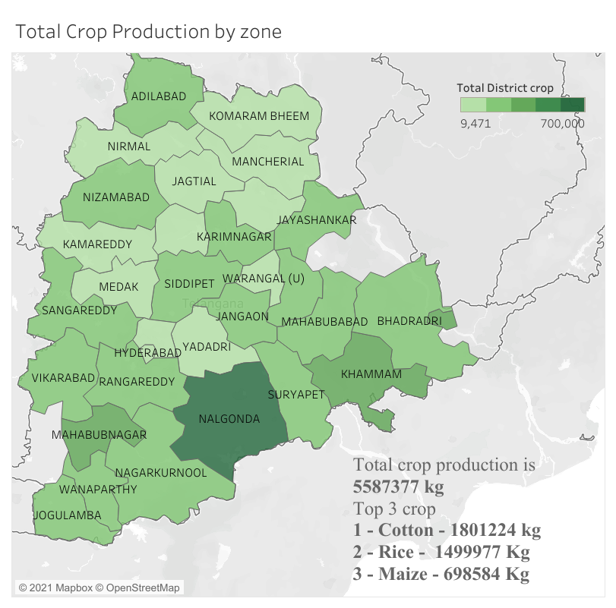

Slide 3
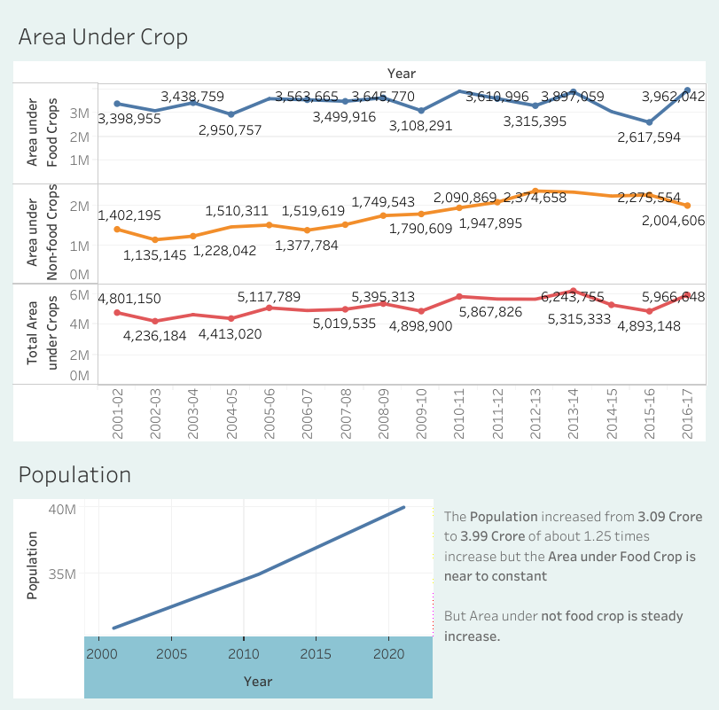

Slide 4
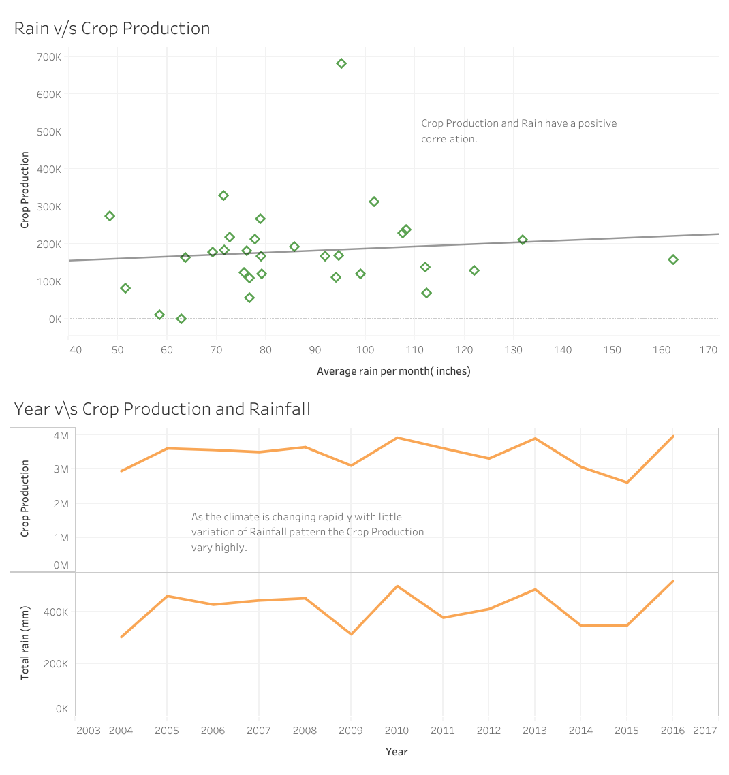
Relation between Rainfall and Crop Production

Slide 5
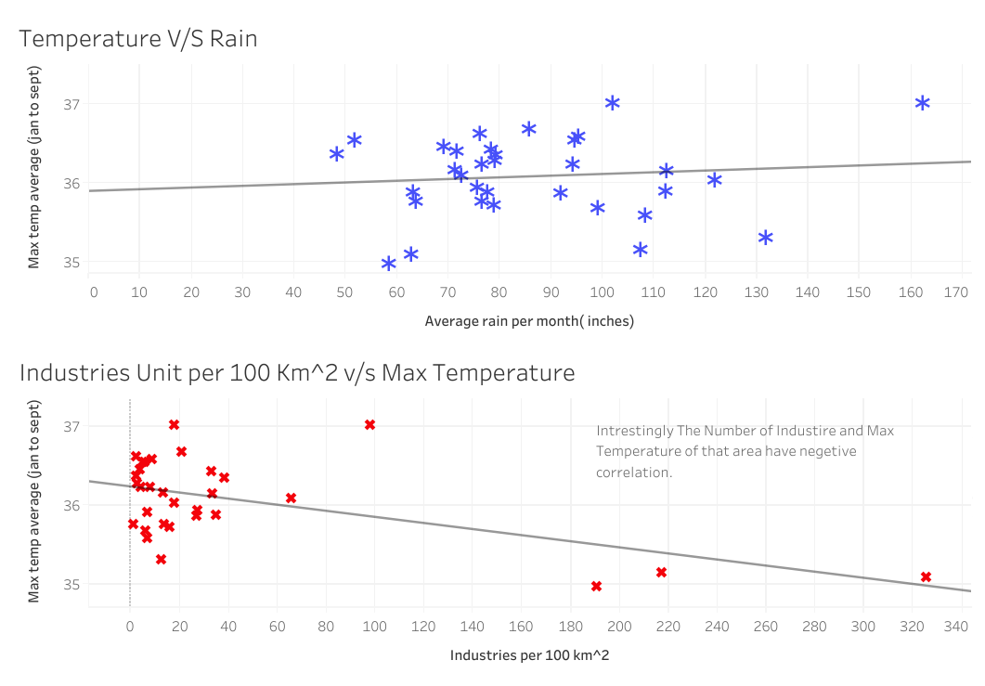
Rain, Temperature and Industries

Slide 6
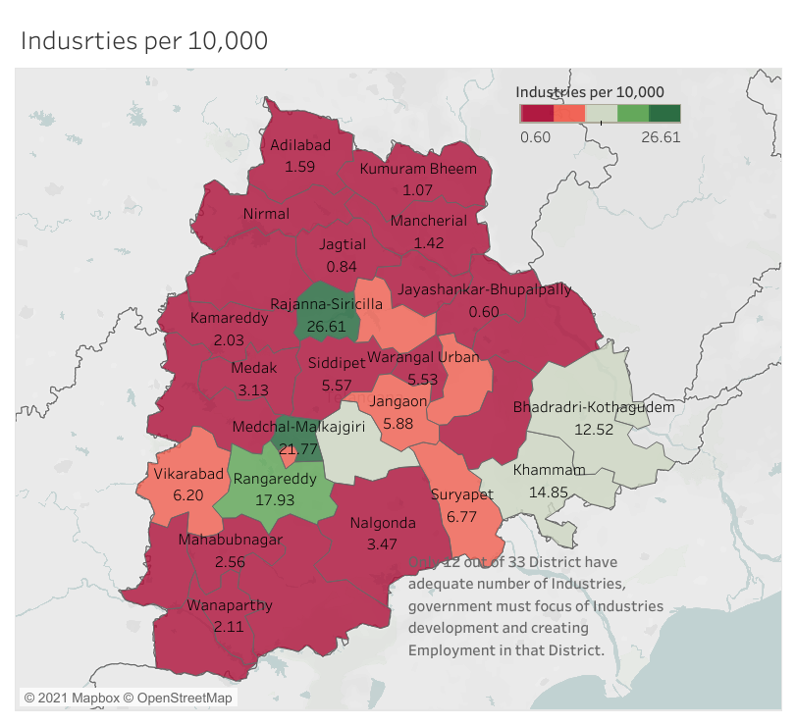
Telangana Industries Density Telangana have a total of 33 district out of which only 12 district have medium to high industrial zones.

Slide 7
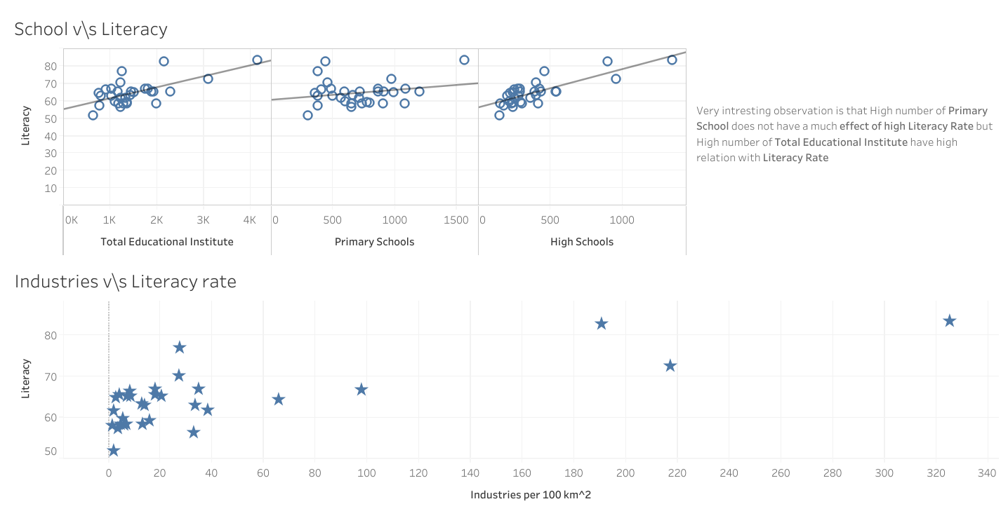
School, Literacy, Industries

Slide 8
Conclusion
Nalgonda has the highest crop production so Farming industries can easily be setup and it can be centre for agriculture research.
The Population increase is rapid compared to crop land so productivity per unit area land must be taken care.
Due to Rapid climate change a small change in rainfall pattern lead to bigger change in cropping pattern and area.
Industries does not always have negative climate impact.
Government should focus on outskirts area of Telangana as the industries to population ratio is very less and they depend on farming.
Building number of primary school does not alone increase the literacy rate other factors also play an important role like sanitation, quality.

